Slide 1
JavaScript Object-Oriented Programming

Slide 2
What is Object-Oriented Programming?
An approach to problem solving where all computations are carried out using objects
We already know what an object is: a data structure with its own properties or attributes and its own procedures or methods
In object-oriented programming (OOP), these objects interact with each other

Slide 3
Benefits of OOP
Code is faster and easier to execute
Provides a clear structure for a program
Makes code easier to modify, debug and maintain
Makes it easier to reuse code

Slide 4
JavaScript Classes
JavaScript classes are a tool/template for generating multiple standardized objects with shared characteristics (properties) and behavior (methods)
Classes are a core part of object-oriented programming (OOP)

Slide 5
JavaScript Classes (cont’d)
In OOP, objects are created as specific instances of a class, sharing a class’s properties and methods
Ex: in a multiplayer game, each player might be represented as an object of a Player class, and each enemy might be represented as an object of an Enemy class

Slide 6
JavaScript Classes (cont’d)
A Player class in a game might include properties such as:
Player’s name
Health level
Position in the environment

Slide 7
JavaScript Classes (cont’d)
A Player class might include methods such as:
Moving
Firing a weapon
Picking up an item
The class could then be used to create multiple players

Slide 8
JavaScript Classes (cont’d)
Here is our scenario:
We are creating classes for a game with user-controlled players and computer-controlled enemies
The object of the game is for the players to avoid enemy attacks (perhaps in a maze the player needs to exit)
Players cannot attack enemies but enemies can attack players
Players start with 100 health points and lose 10 health points on every successful enemy attack

Slide 9
JavaScript Classes (cont’d)
A specific Player instance would have its own details distinct from other Player instances: its own name, health level, and position. But all instances could use the methods of the Player class.

Slide 10
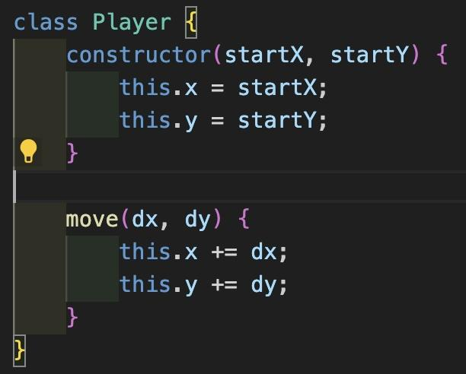
JavaScript classes in action
We declare a class with the class keyword
We capitalize the name of the class
In the body, we define two methods:
constructor()
move()

Slide 11
The constructor method
If a class has a constructor method, it is called automatically anytime an instance of the class is created
The constructor performs any necessary setup for the object being created, including:
receiving any parameters that define the instance
laying out what properties the object should have

Slide 12
The constructor method (cont’d)
The constructor takes two parameters, startX and startY, and assigns them to the new instance’s x and y properties
The x and y properties are keeping track of the players position in this game (2D)

Slide 13
The keyword “this”
The this keyword refers to the current instance being created
this.x = startX means “take the value of startX and assign it to the new Player object’s x property”

Slide 14
The move method updates the player’s position by changing the x and y properties based on the provided dx and dy parameters

Slide 15
Side note - dx and dy
Why did we name the parameters dx and dy? The d is short for the Greek letter delta, which often refers to the amount something changes, so dx is “change in the x value” and dy is “change in the y value.” If you look at a lot of game code, you will see most of the games having parameters named dx and dy referring to a change in position.

Slide 16
Creating an instance of the Player class
let player1 = new Player(0, 0);
We create a new instance of the class by:
Using the new keyword followed by the class name
Following the class name with a set of parentheses (like when calling a function)
Including in the parentheses any arguments that need to be passed to the constructor method

Slide 17
Creating an instance (cont’d)
Behind the scenes:
JavaScript creates a new object
JavaScript creates a hidden link between the new object and the class
JavaScript calls the class’s constructor method, passing the arguments 0 and 0 to the constructor’s startX and startY parameters
The constructor takes the parameters and uses this.x and this.y to set the new object’s x and y properties to 0
The new object is returned and assigned to the player1 variable

Slide 18
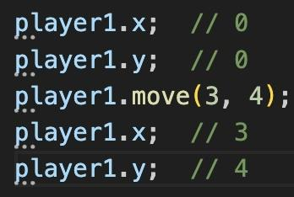
We access the x and y properties and the move method using dot notation
We can access the class’s move method because of the hidden link between the object and the class

Slide 19
More on “this”
When we call a method on an object, the this keyword inside the method definition is set to the current object (the receiver)
When we call player1.move(3, 4), this inside the body of move is bound to the player1 object
That’s how one method can be shared by multiple objects - this becomes whatever object is receiving the method call at any given time

Slide 20
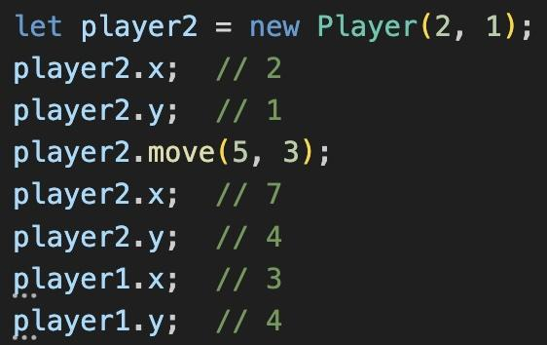
Comparing two instances
player1 and player2 each has its own x and y properties, but both have access to the move method

Slide 21
Inheritance
Inheritance is a mechanism for defining relationships between different classes
Like a child inheriting genes from its parents, a “child” class inherits properties and methods from a “parent” class, taking on the parent’s properties and methods
Useful when we have multiple classes that should share a general set of behaviors, in addition to each class having some unique behaviors of its own

Slide 22
Inheritance (cont’d)
Inheritance lets us define general behaviors as part of a parent class (a superclass)
We can then define the child classes (subclasses) to inherit these behaviors and augment them with other, specialized behaviors
Saves us from having to repeat the general code when defining each subclass

Slide 23
Inheritance in action - players and enemies
Things in common:
Need x and y properties representing position
Need a move method to change their position
Differences:
Enemies can attack the player if the player comes too close
For this game, players cannot attack enemies (the goal is to avoid them)

Slide 24
Inheritance in action (cont’d)
Create Actor class to represent any participant in game
Hold general code both players and enemies should have
Define Player and Enemy as subclasses of Actor
They’ll each inherit the general code from the Actor superclass while also adding their own code particular to just players or enemies

Slide 25
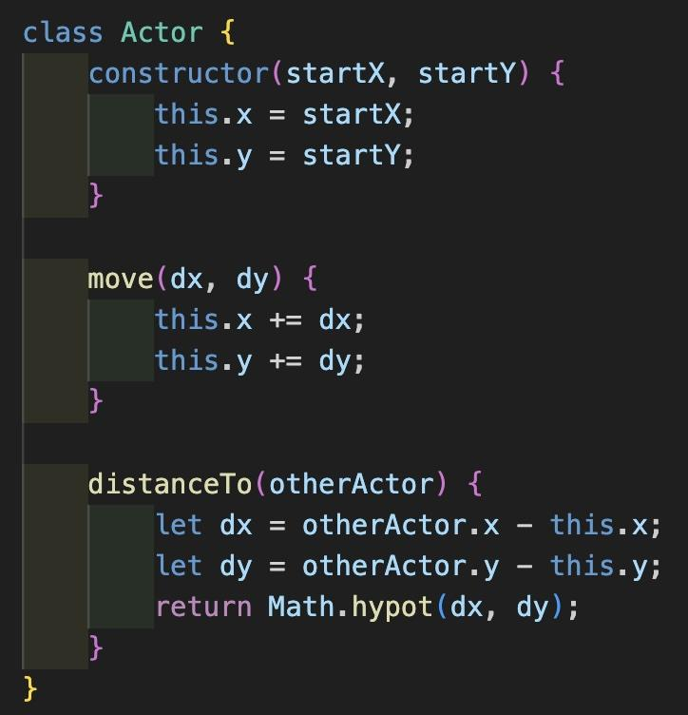
Inheritance in action (cont’d)

Slide 26
Inheritance in action (cont’d)
distanceTo()
takes another Actor (or any object with x- and y-coordinate) as a parameter and returns the distance to that object
passing an object into other objects’ methods is quite common

Slide 27
Inheritance in action (cont’d)
Abstract classes
Represent an abstract concept, like a generic entity in a game
Not meant to be instantiated (have an instance of it created)
Just meant to be extended by a subclass

Slide 28
Inheritance in action (cont’d)
Concrete classes
Meant to be instantiated
Represent something solid, such as actual players or enemies

Slide 29
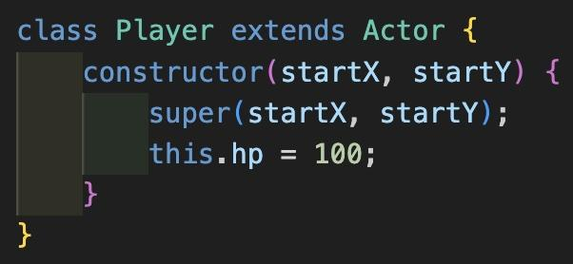
Inheritance in action (cont’d)
Player class inherits from Actor
keyword extends establishes Player as a subclass of Actor
New property (hp) added that is specific to players alone

Slide 30
Inheritance in action (cont’d)
Only need to write constructor method
class inherits move and distanceTo methods from Actor
constructor takes startX and startY parameters like before

Slide 31
Inheritance in action (cont’d)
Keyword super refers to the constructor from the superclass (Actor)
When we create a new instance of Player, the Player constructor is called automatically, which then calls the Actor constructor

Slide 32
Inheritance in action (cont’d)
We pass startX and startY to the Actor constructor
Actor constructor uses these to set the Player object’s x and y properties

Slide 33
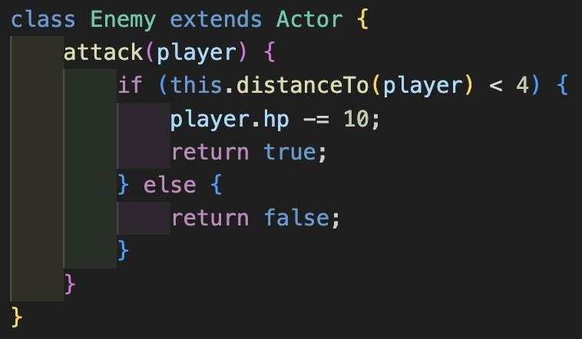
Inheritance in action (cont’d)
Enemy class inherits from Actor class and extends it with an attack method for attacking players (Player class doesn’t need because only enemies can attack)

Slide 34
Inheritance in action (cont’d)
Enemy class needs no constructor because it has no extra properties that need to set in the constructor
Actor constructor will be called automatically when an instance of Enemy is created
Enemy instances will still be given an initial position thanks to Actor’s constructor method

Slide 35
Inheritance in action (cont’d)
attack - Enemy’s only unique method
Takes Player object as parameter and checks distance to it using distanceTo method inherited from Actor class
If distance is less than 4, enemy can attack, reducing player’s hp value by 10
Returns true to indicate success
If attack fails because player is too far away, returns false instead

Slide 36
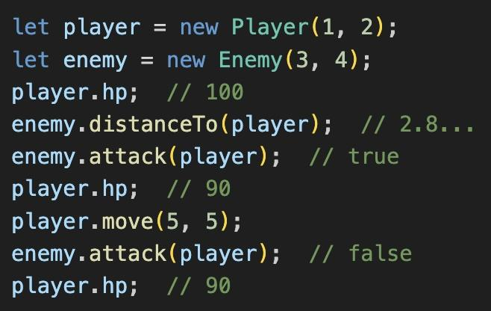
Interfaces in action (cont’d)
Notes:
First we create an instance of each class, at the positions (1, 2) and (3, 4). The Player object starts out at full health, as player.hp demonstrates. The two objects are about 2.8 units apart, which we confirm by calling enemy .distanceTo(player). At this point, the enemy is close enough to successfully attack the player, so we call its attack method using enemy.attack(player). The method returns true, indicating a hit, and checking player.hp shows the attack has reduced the player’s health to 90. Next, we move the player by 5 units in the x and y directions. The move puts the player out of range of the enemy, so the enemy’s second attack is unsuccessful, returning false. A last check of player.hp shows the player’s health remains at 90.

Slide 37
Inheritance in action (cont’d)
Called distanceTo on an Enemy object and move on a Player object
Both methods defined on Actor class, but available on Enemy and Player classes as well
Proves subclasses successfully inherited from their superclass

Slide 38
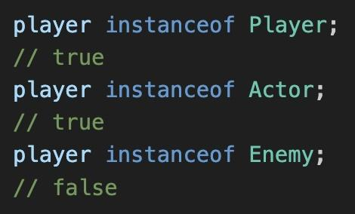
Inheritance in action (cont’d)
player is an instance of Player
player is also an instance of Actor
When a subclass inherits from a superclass, instances of the subclass are also considered to be instances of the superclass
player is not an instance of Enemy, even though they share a common superclass

Slide 39
Inheritance in action (cont’d)
Single level of inheritance - Actor superclass with Player and Enemy subclasses
Could use multiple levels of inheritance to create different subtypes of players and enemies
Player subclasses could be Witch, Elf, Centaur
Those subtypes/subclasses would share some common abilities defined on both Player superclass and Actor superclass while having their own specialized abilities defined on the individual subclasses
Enemy subclasses could be Troll, Demon, Harpy

Slide 40
Prototype-based inheritance
JavaScript classes are a recent addition
Before classes, JavaScript used prototype-based inheritance to share behavior between objects
it’s still in use today and even works alongside the class system

Slide 41
Prototype-based inheritance (cont’d)
Prototype-based inheritance (we’ll call it PBI) relies on two mechanisms:
A constructor function
A prototype

Slide 42
PBI Constructor functions
In PBI, a constructor function creates and returns new objects
It is a regular, standalone function, not a function defined in a class
It is called using the new keyword

Slide 43
PBI prototypes
In PBI, a prototype is an example object that the constructor uses as a model for the objects it creates
Newly created objects inherit methods and properties from the prototype object, similar to how objects inherit from classes in the class system

Slide 44
Class-based inheritance vs prototype-based inheritance
JavaScript was one of the few mainstream classes using PBI rather than classes
Classes were added to make JavaScript more palatable to newcomers from other programming languages

Slide 45
Class-based inheritance vs prototype-based inheritance
Classes were built on top of existing support for PBI
JavaScript class-based inheritance is essentially an alternative syntax for PBI
Sometimes known as syntactic sugar, because it makes the syntax more palatable
Even with class-based inheritance around, it’s good to recognize how PBI works

Slide 46
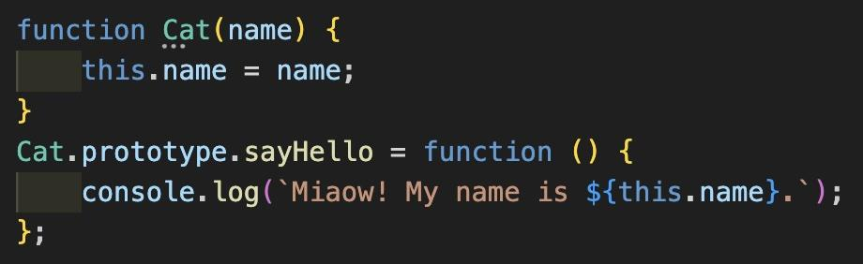

Slide 47
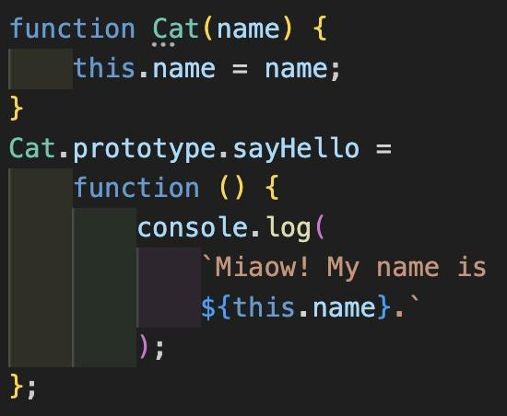
Constructor functions (cont’d)
We create a constructor function called Cat with a name parameter
constructor functions usually start with capital letter
The constructor’s body uses this.name = name to set the new object’s name property with the value of the provided name parameter

Slide 48
Constructor and prototype
When the Cat constructor function is created, it is automatically given a property called prototype
Functions can have properties because they themselves are just a kind of object
The Cat function can have a prototype property just like a person object can have name and age properties
The property is accessible using dot notation (Cat.prototype) just like the property of any other object

Slide 49
Constructor and prototype (cont’d)
The value of Cat.prototype is itself an object, the prototype that Cat instances should be modeled after
By adding methods to this prototype object, we can control what methods any Cat instances will inherit
In our code example, we use Cat.prototype.sayHello to add a sayHello method to the prototype
We create the .sayHello property on the object and set its value to a function expression

Slide 50
Constructor and prototype (cont’d)
The sayHello method logs a greeting that includes the value of this.name to the console
When sayHello is called on a particular instance, the keyword this in the method definition refers to that particular instance (just like with classes), so this.name refers to the value of the instance’s name property

Slide 51
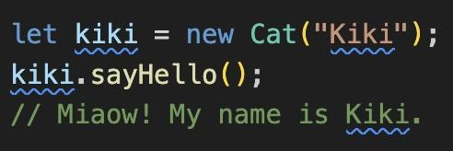
Creating an instance of a prototype
We create a new object from the Cat constructor (using the keyword new) and pass “Kiki” as an argument for the name parameter
We store the resulting object in the kiki variable

Slide 52
Creating a prototype instance vs a class instance
The syntax for creating an object from a class as opposed to from a constructor function is the same
new Cat(“Kiki”)
Only difference is whether we’re thinking of Cat as the name of a function or the name of a class

Slide 53
Calling a prototype method from an object instance
Because kiki was created using the Cat constructor, it has a hidden link to Cat.prototype
JavaScript uses that link to locate the sayHello method when it is called
Since sayHello was called as a method on the kiki object, the this keyword in sayHello is set to kiki

Slide 54
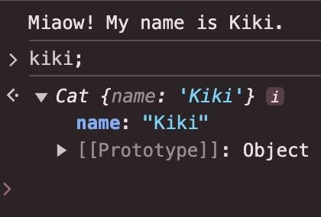
Inspecting the object instance
If we put kiki; into the console and click the arrow to inspect:
First line - tells us kiki was created with the Cat constructor
Second line - tells us kiki has a name property with the value of “Kiki”

Slide 55
Inspecting the object instance (cont’d)
kiki also has a [[Prototype]] property whose value is an object
This is the hidden link to the prototype that this instance inherited from
It’s the same object referenced by Cat.prototype (the prototype of the Cat constructor function)

Slide 56
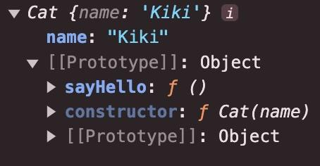
Inspecting the prototype
The prototype object has three properties:
sayHello has a value that’s a function (the method we added to the prototype
constructor refers to the Cat constructor function
This cements the link between the constructor function and the prototype the constructor uses to create new instances

Slide 57
Inspecting the prototype
The prototype object also has its own [[Prototype]] property
In PBI, the chain or references from instance to prototype to constructor is how Javascript knows how to find the methods and properties for the instance
Classes use these same techniques

Slide 58
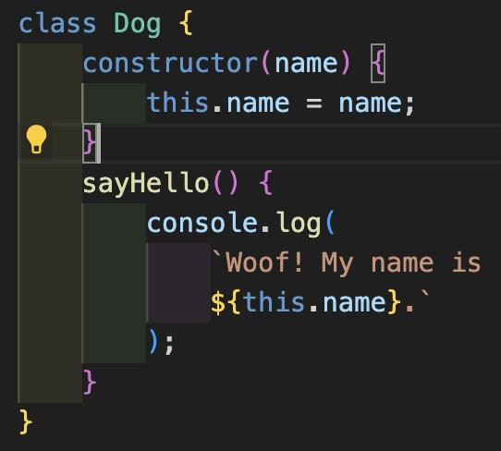
Adding a Dog class
The constructor method here is equivalent to the Cat constructor function
The sayHello method is equivalent to Cat.prototype.sayHello

Slide 59
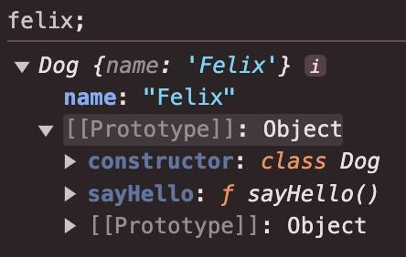
Comparing Cat and Dog objects
Notes:
In both cases, the sayHello method is found via the [[Prototype]] link, with just minor differences. With kiki the constructor points at a function, but with felix it points to a class. The sayHello method on felix has a name, whereas for kiki it doesn’t (we used an anonymous function).

Slide 60
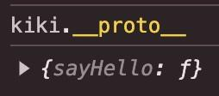
Accessing the [[Prototype]] property
We can access an object’s [[Prototype]] property directly in code through name.__proto__
That’s two underscores at the start and two at the end

Slide 61
Object.prototype
Any object not created with an explicit constructor function is implicitly created with JavaScript’s built-in Object constructor function
This function references Object.prototype as its prototype
Object.prototype contains basic methods that all objects should inherit

Slide 62
Object.prototype (cont’d)
Object.prototype is the final prototype in the chain of prototype references
Its [[Prototype]] property’s value is null
All objects eventually trace their origin back to Object.prototype

Slide 63
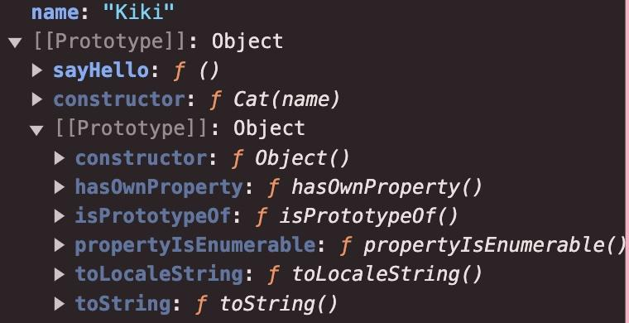
kiki and Object.prototype
Notes:
While kiki object was created with Cat constructor, its prototype, Cat.prototype, was never explicitly created with a constructor. JavaScript created it using the Object constructor, so its prototype is Object.prototype
Notice the inner prototype object has a constructor property whose value is the Object function, showing its the prototype property of JavaScript’s built-in Obect constructor. The remaining properties correspond to the default methods all objects inherit

Slide 64
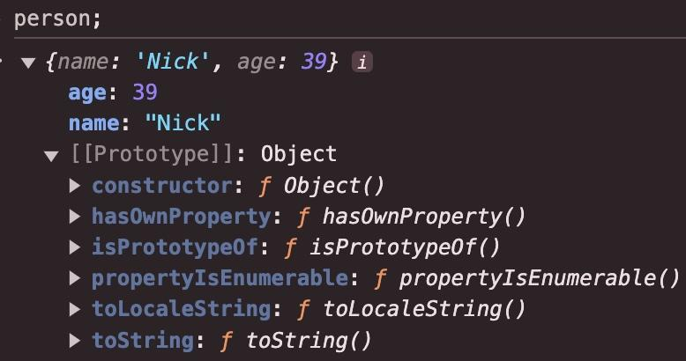
Prototypes of object literals
Notes:
Object literals aren’t created with an explicit constructor function, so they are created implicitly with the Object constructor and have Object.prototype for their prototype. You can see the contents of the prototype here are exactly the same as those for the innermost prototype of the kiki object

